Slide 1
Multi-level Models: An Introduction
Introduction to Multi-level Models (MLM)
Data Structure
Examples
Model
Classical Regression vs. MLM
Data Generation
MLM in R
Model Comparison
MLM in WinBUGS
Model Convergence
Uncertainty Intervals
Model Variances
Future Research
More Information

Slide 2
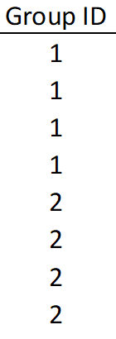
Data Structure
A multi-level model (MLM) has two data sets- one dataset containing information on individuals and one dataset that contains information about the groups in which those individuals belong.

Slide 3
Examples
People within cities
Labor within industry
Players within teams
Citizens within communities
Genes within animals
Risk within markets
Information within systems

Slide 4
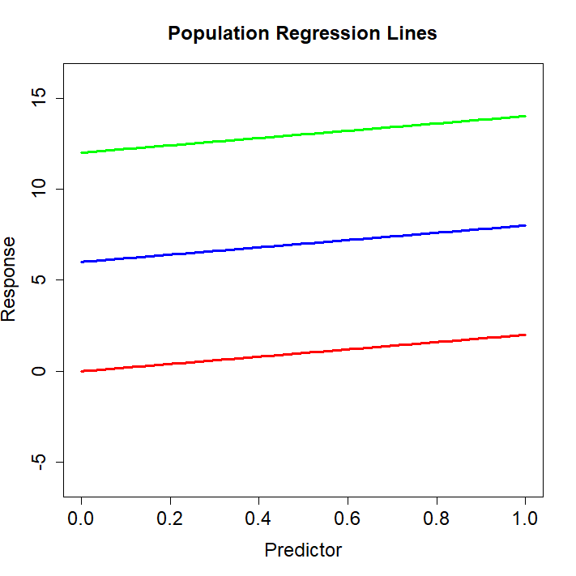
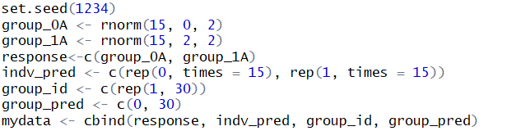
Data Generation

Slide 5
Multi-Level Model
Group-level Regression (MLM)
Individual-level Regression (MLM)

Slide 6
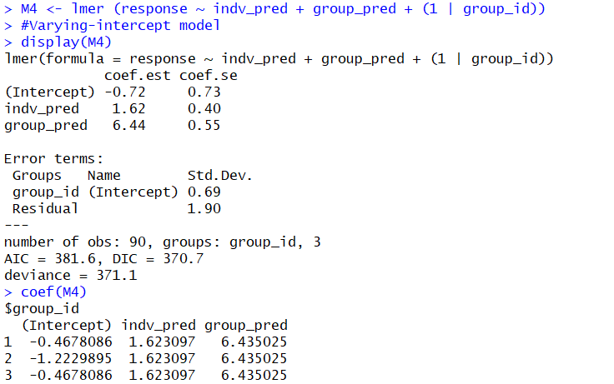
MLM in R
Library(“lme4”)

Slide 7
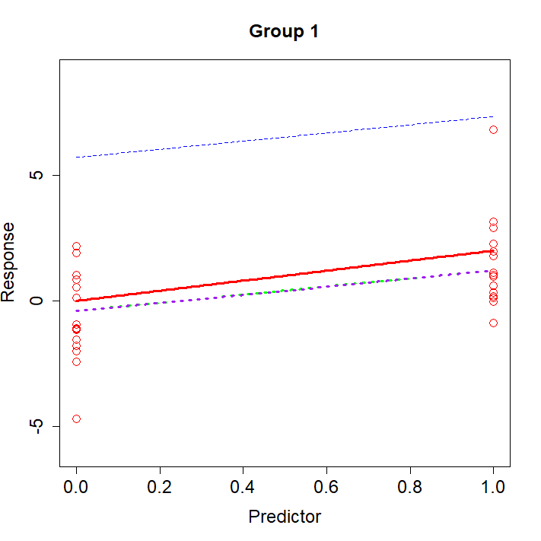
Group 1:
Parameters | Y=0 | Y=2
Classic | -.4044 | 1.2187
MLM | -.4678 | 1.1552
Model Fit | SSE | cumsum(sse_j)
Classic | .774 | .774
MLM | .932 | .932
Notes:
Population Model
The population regression lines below are not a function of the data.
Pooled
Unpooled
Multi-level (individual)
Group-level

Slide 8
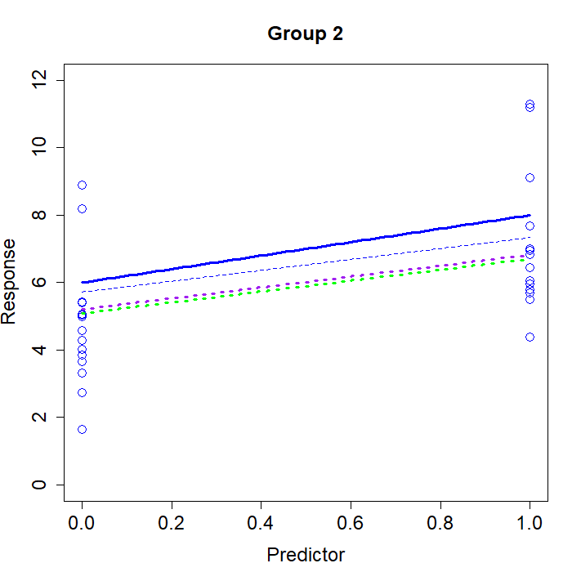
Group 2:
Parameters | Y=6 | Y=8
Classic | 5.085 | 6.078
MLM | 5.212 | 6.835
Model Fit | SSE | cumsum(sse_j)
Classic | 2.505 | 3.28
MLM | 1.978 | 2.91
Notes:
Population Model
The population regression lines below are not a function of the data.
Pooled
Unpooled
Multi-level (individual)
Group-level

Slide 9
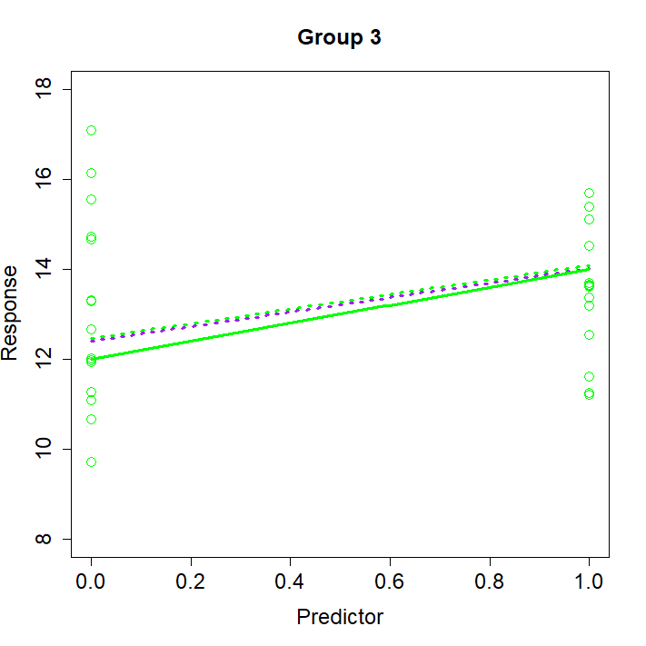
Group 3:
Parameters | Y=12 | Y=14
Classic | 12.47 | 14.09
MLM | 12.41 | 14.02
Model Fit | SSE | cumsum(sse_j)
Classic | 0.225 | 3.5
MLM | 0.162 | 3.1
Notes:
Population Model
The population regression lines below are not a function of the data.
Pooled
Unpooled
Multi-level (individual)
Group-level

Slide 10
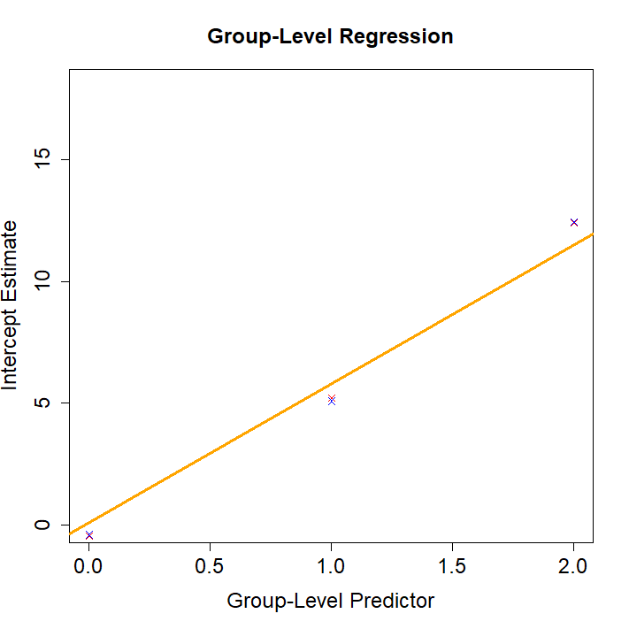
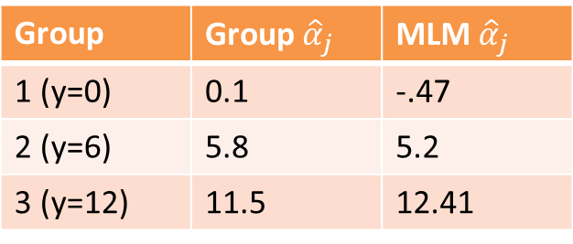
Group-Level Regression:
Group | Group ${\hat{α}}_{j}$ | MLM ${\hat{α}}_{j}$
1 (y=0) | 0.1 | -.47
2 (y=6) | 5.8 | 5.2
3 (y=12) | 11.5 | 12.41
Notes:
Population Model
The population regression lines below are not a function of the data.
Pooled
Unpooled
Multi-level (individual)
Group-level

Slide 11
More Information
Gelman and Hill, Data Analysis Using Regression and Multilevel/Hierarchical Models. (2007)
Home Page for Gelman and Hill
http://www.stat.columbia.edu/~gelman/arm/
Radon Data Set
http://www.stat.columbia.edu/~gelman/arm/examples/radon/
LEMMA (Learning Environment for Multilevel Methodology and Applications). https://www.cmm.bris.ac.uk/lemma/
National Centre for Research Methods. University of Bristol.
Cross Validated. https://stats.stackexchange.com/

Slide 12
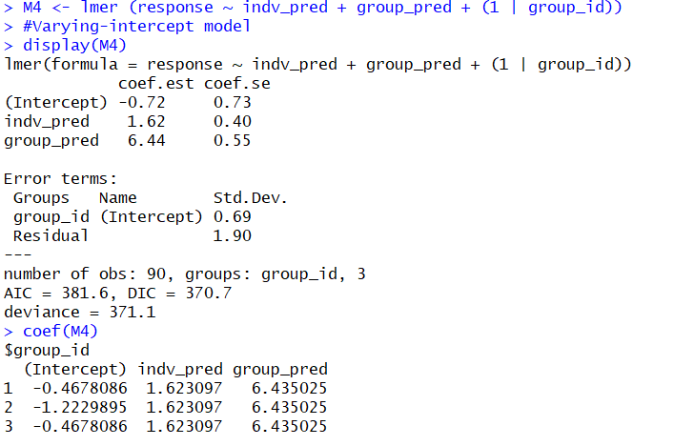

Slide 13
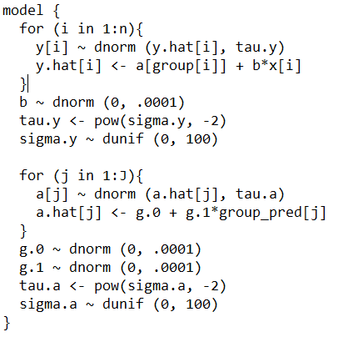
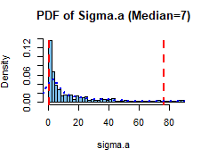

Slide 14
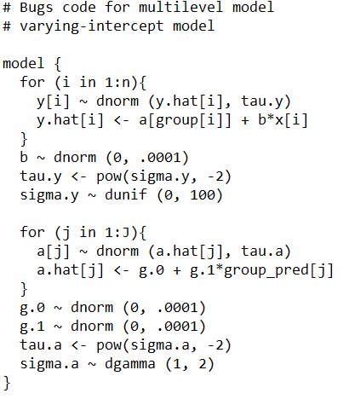
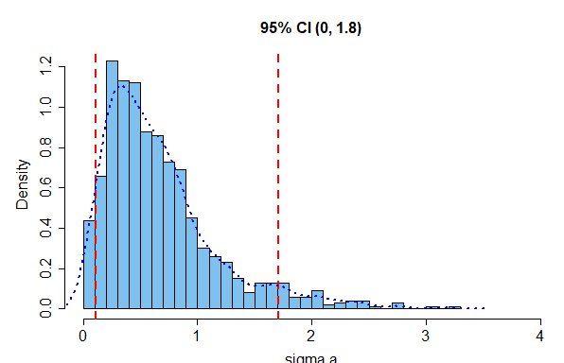

Slide 15
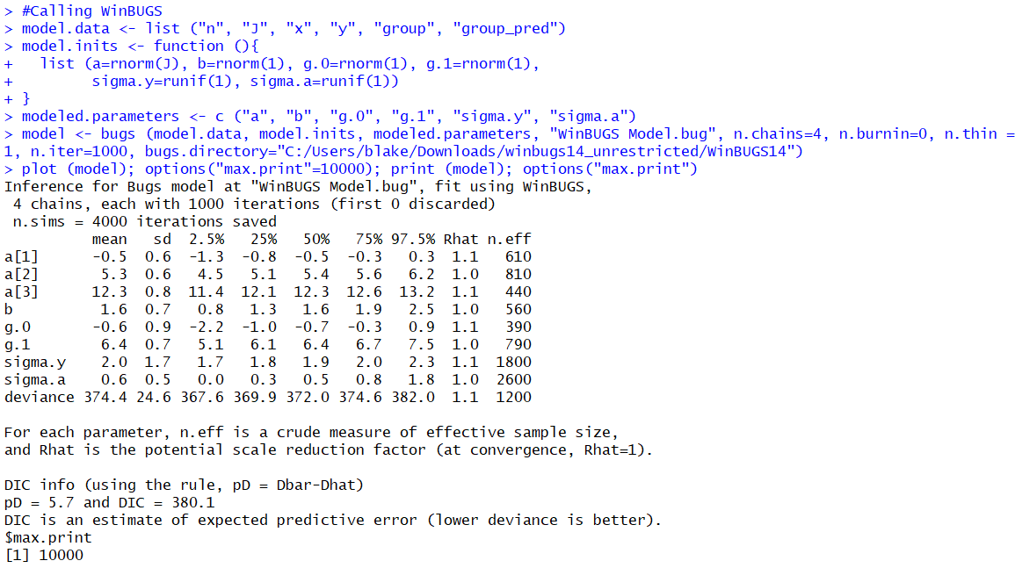

Slide 16
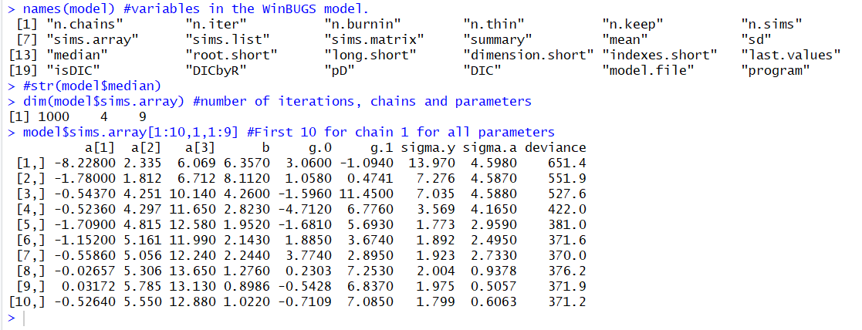

Slide 17
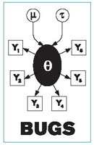
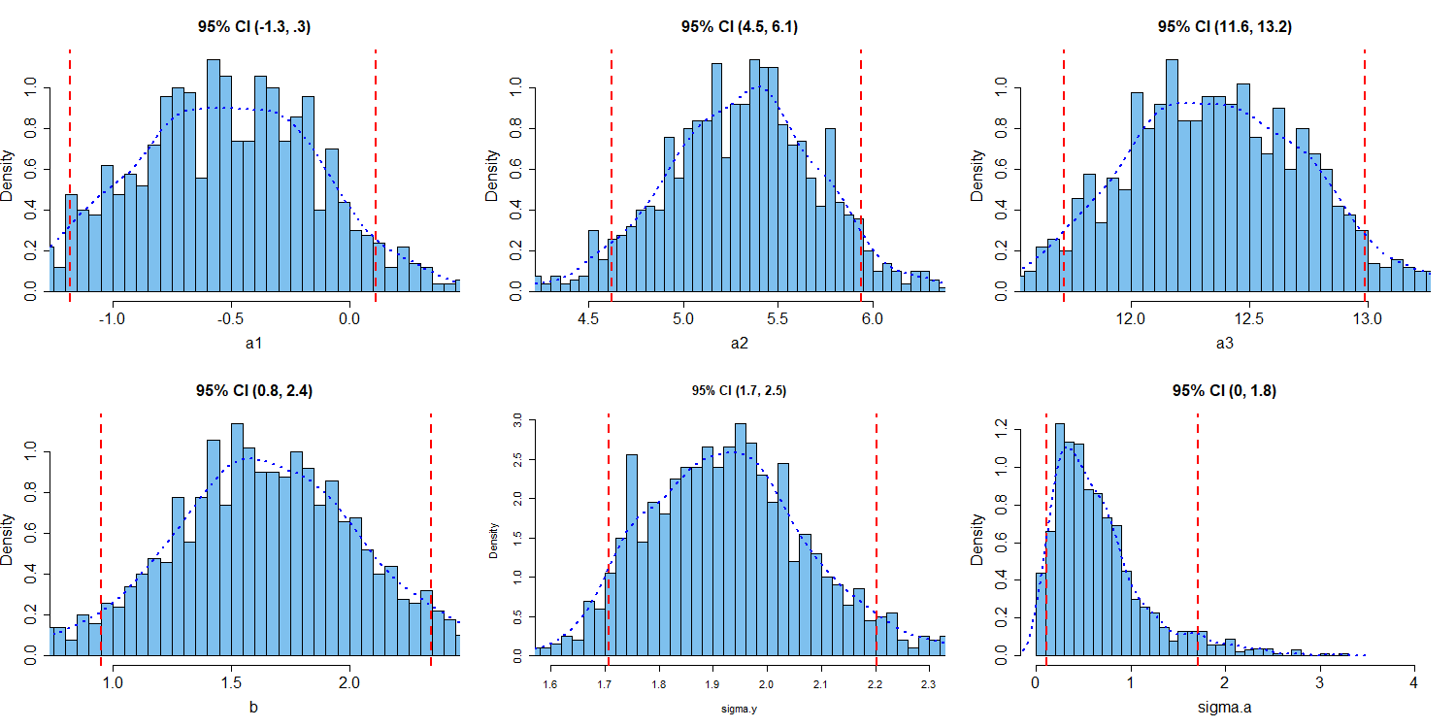
Bayesian Uncertainty Intervals
Notes:
Population Model
The population regression lines below are not a function of the data.
Pooled
Unpooled
Multi-level (individual)
Group-level

Slide 18
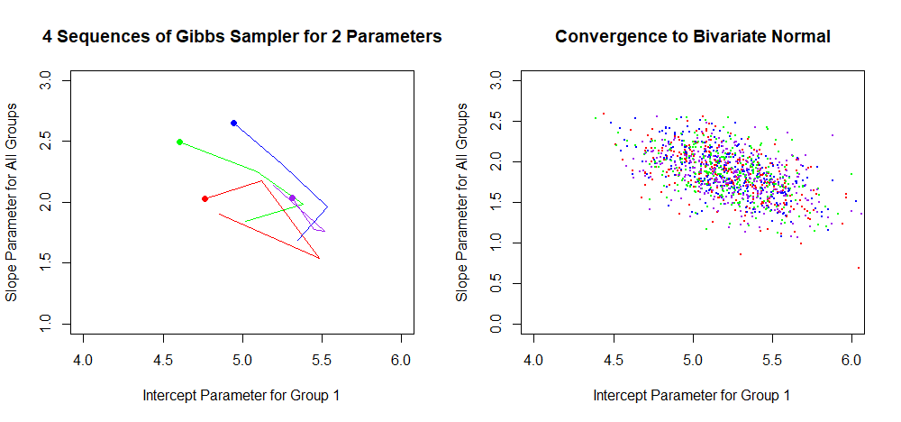
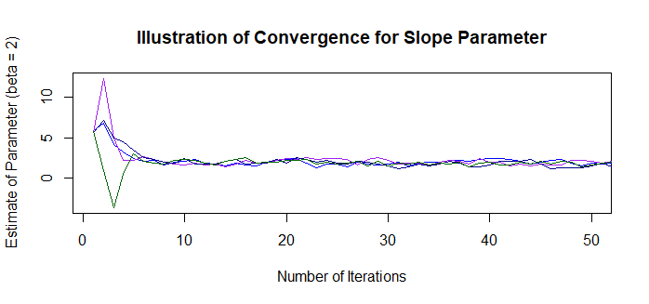

Slide 19
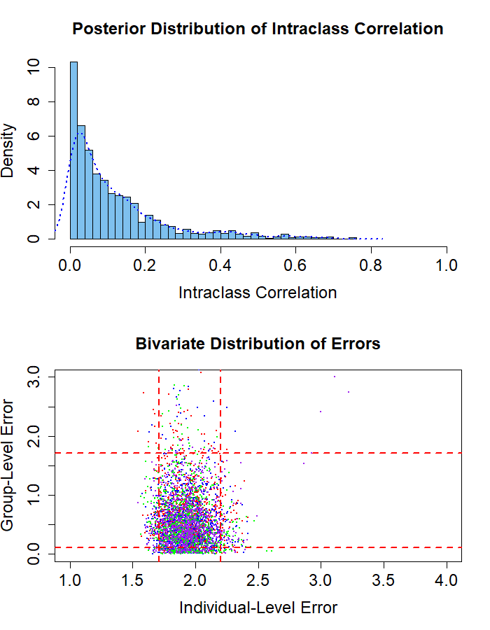
Variances:
Same % as coefficients!!!
Notes:
Population Model
The population regression lines below are not a function of the data.
Pooled
Unpooled
Multi-level (individual)
Group-level

Slide 20
Future Research
Varying n for a particular group: Theory states that decreasing sample size increases the “pull” of the group-level regression line relative to the un-pooled regression line. In other words, with a smaller n, the group-level model has a stronger effect on the estimate of the intercept parameter.
Investigate prior distribution for group-level variance: Group-level variance is right-skewed. What is the analytical explanation for this phenomenon and the mathematical justification for bounding the initial values of the group-level variance?
More MLM Model Validation: Run classic model in WinBUGS to compare deviance information criterion. Systematically testing other seeds or choosing a different metric for “apples-to-apples” comparison would validate this approach.
Varying intercept models: Including a varying slope and comparing to a classical regression with interactions.
Solve posteriors by integrating prior distribution rather than use of MCMC

